Slide 1


“MONEY TRANSFER
APPLICATION”
Task - 4
“Your Project Name”
Task - 4

Slide 2


Money Transfer Application
Money Transfer Application
Your Project Introduction
▪
A Money Transfer Application offers a secure and user-friendly solution for seamless fund transfers and financial management, empowering developers to create a cutting-edge financial tool.
LMS Username | Name | Batch
LMS Username
Name
Batch
au420420205018
Naveenkumar I
CA2
au420420205003
Baranidharan R
CA2
au420420205008
Gokulakrishnan K
CA2
au420420205306
Vasanthkumar J S
CA2

Slide 3
Task 4 :: Dynamic Frontend
Integrate the APIs to frontend to ensure the dynamic feature of website
Point base api to the severs base url
Design api calls for each element
Handle errors in the output
Render output of apis to different low level components
Secure content of post apis
Evaluation Metric:
100% Completion of the above tasks
Learning outcome
Developing complicated UI using HTML components
Using props drilling and context to pass variables
Getting familiar with different type of api calls
Handling different input data

Slide 4
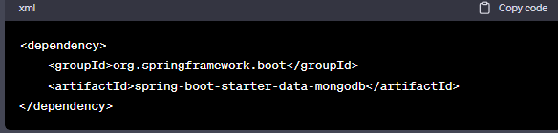
Step-Wise Description
Step1: Set Up a Spring Boot Project
Install Spring Boot:
If you haven't already, install Spring Boot. You can use tools like Spring Initializer (https://start.spring.io/) or your preferred IDE (e.g., IntelliJ, Eclipse) to set up a new project. Choose the necessary dependencies, such as Spring Web and Spring Data MongoDB.
Create a Spring Boot Project:
Create a new Spring Boot project using your chosen method. This will generate the basic project structure with a main application class
Step2: Configure MongoDB Connection
Add MongoDB Dependency:
In your pom.xml file, add the MongoDB dependency. For example:

Slide 5
Step3: Create Data Models
Define MongoDB Entities:
Create Java classes that represent your MongoDB entities. Annotate these classes with @Document and other necessary annotations to map them to MongoDB documents.
Step4: Implement Repository
Create Repositories:
Create Spring Data repositories by extending the MongoRepository interface. These repositories will handle the CRUD operations for your entities
Step5: Develop REST APIs
Build REST Controllers:
Create REST controllers using the @RestController annotation. Define endpoints that handle HTTP requests, interact with your MongoDB repositories, and return appropriate responses.
Test Endpoints:
Test your REST endpoints using tools like Postman or cURL. Ensure that data is being stored/retrieved from MongoDB as expected.

Slide 6

The backend design of the money transfer application is built on the Spring Boot framework, employing MongoDB as the database. In the initial step, a Spring Boot project is established with essential dependencies, particularly Spring Web and Spring Data MongoDB. The MongoDB connection is configured by adding dependencies and specifying connection properties in the application properties file. Data models representing MongoDB entities are then defined, adorned with appropriate annotations to facilitate mapping to MongoDB documents.
The subsequent step involves the implementation of repositories by extending the MongoRepository interface, facilitating seamless handling of CRUD operations for the specified entities. Finally, RESTful APIs are developed using Spring Boot's @RestController annotation, defining endpoints that manage HTTP requests, interact with MongoDB repositories, and deliver suitable responses.

Slide 7
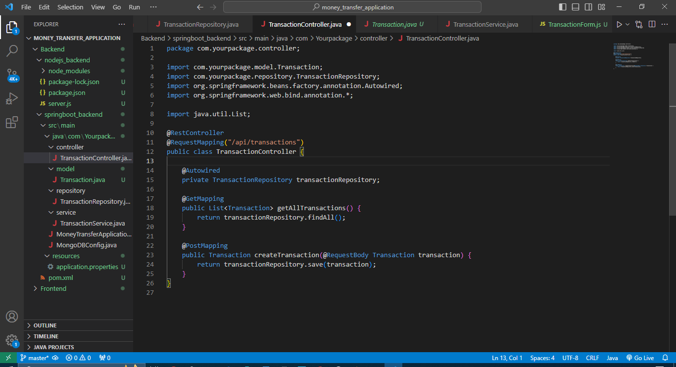
Project Backend Struture:

Slide 8
Assessment Parameter
Design Schema for data to be stored
Point all routes with a appropriate controllers to control request and response
Set mongodb server on localhost
Check-List
Add authentication middleware to all protected routes
Add dummy data with schema in mongodb server
Filter and santize all the incoming data in http requests
Run some test queries to test the server
Set up secure environment variables for secret keys

Slide 9
Submission Github
https://github.com/Naveenkumar-17/NM-APEC-IT-GROUP1

